Slide 1
Smart Water Management
Presented by Pro-Decoder

Slide 2

CODE IMPLEMENTATION & PLANNING
Smart water management involves using technology to monitor, control, and optimize water resources efficiently. To implement smart water management, you can use various programming languages and technologies, depending on your specific needs and the devices or sensors you're working with. Here's a general outline of the steps and some code snippets in Python to get you started

Slide 3
Data Collection and Sensors:
Connect sensors (e.g., flow meters, water level sensors) to a microcontroller or single-board computer (e.g., Raspberry Pi).
With the help of sensors, a smart city water management system can enable you to collect real-time data—information that helps you visualize water distribution across the network. Residents with smart meters can make more informed decisions as a result, leading to a more sustainable city overall.

Slide 4
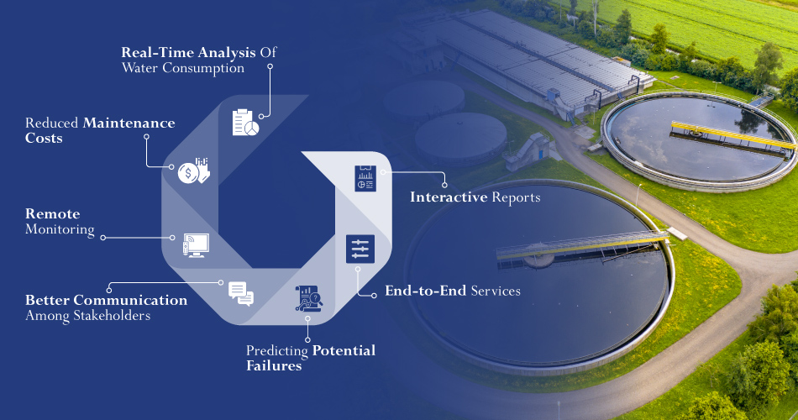
Structure of Water Management

Slide 5
Code for Data collection
import RPi.GPIO as GPIO
# Initialize GPIO pins for sensors
GPIO.setmode(GPIO.BCM)
flow_sensor_pin = 17
GPIO.setup(flow_sensor_pin, GPIO.IN, pull_up_down=GPIO.PUD_UP)

Slide 6
Data Acquisition:
Read data from sensors and collect it at regular intervals.
def read_water_flow():
count = 0
while True:
try:
GPIO.wait_for_edge(flow_sensor_pin, GPIO.FALLING)
count += 1
except KeyboardInterrupt:
break
return count

Slide 7
Data Transmission:
import requests
def send_data_to_server(data):
api_url = "https://yourserver.com/api/waterdata"
headers = {"Content-Type": "application/json"}
payload = {"flow_rate": data}
response = requests.post(api_url, json=payload, headers=headers)
if response.status_code == 200:
print("Data sent successfully.")
else:
print("Failed to send data.")

Slide 8
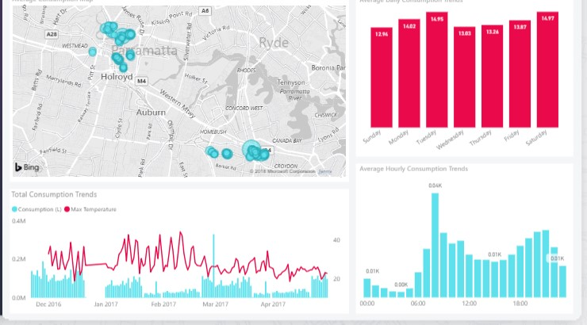
Data Analysis:
Process and analyze the data to identify trends or anomalies. This may involve machine learning or statistical analysis.

Slide 9
Data Transmission:
Send data to a central server or cloud platform for analysis.
import requests
def send_data_to_server(data):
api_url = "https://yourserver.com/api/waterdata"
headers = {"Content-Type": "application/json"}
payload = {"flow_rate": data}
response = requests.post(api_url, json=payload, headers=headers)
if response.status_code == 200:
print("Data sent successfully.")
else:
print("Failed to send data.")

Slide 10
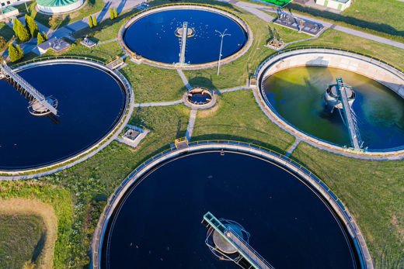
WasteWater Management

Slide 11
Methods of WasteWater Management
Primary Treatment
Secondary Treatment
Tertiary Treatment
Advanced Treatment
Disinfection
Water Reuse and Recycling
Anaerobic Digestion
Constructed Wetlands
Septic Systems
Stormwater Management

Slide 12
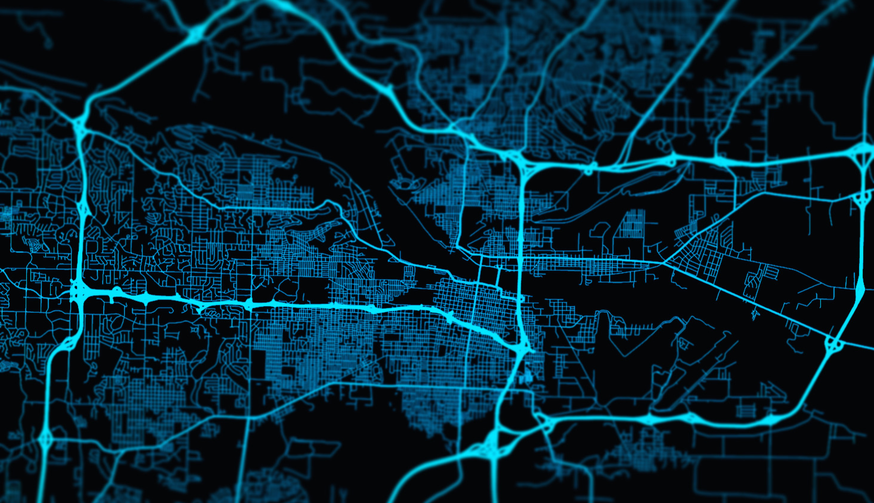
THANK YOU

